Slide 1

Chapter 10: Project Communications Management
Information Technology Project Management, Eighth Edition
Note: See the text itself for full citations.

Slide 2
Learning Objectives
Understand the importance of good communications on projects and the need to develop soft skills, especially for IT project managers and their teams
Review key concepts related to communications
Explain the elements of planning project communications and how to create a communications management plan
Describe how to manage communications, including communication technologies, media, and performance reporting

Slide 3
Learning Objectives (cont’d)
Discuss methods for controlling communications to ensure that information needs are met throughout the life of the project
List various methods for improving project communications, such as running effective meetings, using various technologies effectively, and using templates
Describe how software can enhance project communications management

Slide 4
Importance of Good Communications
The greatest threat to many projects is a failure to communicate
Our culture does not portray IT professionals as being good communicators
Research shows that IT professionals must be able to communicate effectively to succeed in their positions
Strong verbal and non-technical skills are a key factor in career advancement for IT professionals

Slide 5
2014 Study on Importance of Non-technical Skills
Most important non-technical skills include problem solving, teamwork, and listening
Some organizations will hire individuals with minimal technical skills so long as they demonstrate solid soft and business skills

Slide 6
Project Communications Management Processes
Planning communications management: Determining the information and communications needs of the stakeholders
Managing communications: Creating, distributing, storing, retrieving, and disposing of project communications based on the communications management plan
Controlling communications: Monitoring and controlling project communications to ensure that stakeholder communication needs are met

Slide 7
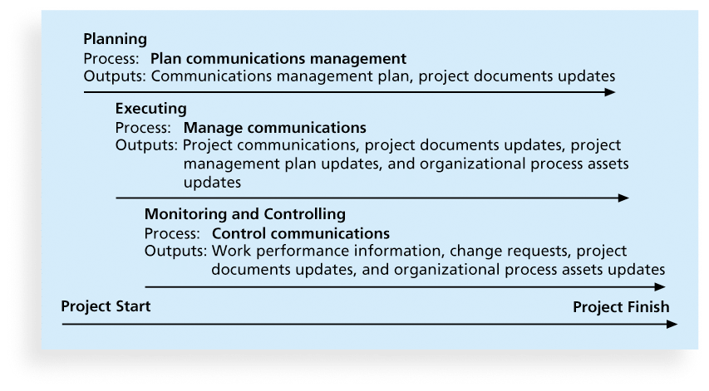
Figure 10-1. Project Communications Management Summary

Slide 8
Keys to Good Communications
Project managers say they spend as much as 90 percent of their time communicating
Need to focus on group and individual communication needs
Use formal and informal methods for communicating
Distribute important information in an effective and timely manner
Set the stage for communicating bad news
Determine the number of communication channels

Slide 9
Understanding Group and Individual Communication Needs
People are not interchangeable parts
As illustrated in Brooks’ book The Mythical Man-Month, you cannot assume that a task originally scheduled to take two months of one person’s time can be done in one month by two people
Nine women cannot produce a baby in one month!

Slide 10
Importance of Face-to-Face Communication
Research says that in a face-to-face interaction:
58 percent of communication is through body language.
35 percent of communication is through how the words are said
7 percent of communication is through the content or words that are spoken
Pay attention to more than just the actual words someone is saying
A person’s tone of voice and body language say a lot about how he or she really feels

Slide 11
Personal Preferences Affect Communication Needs
Introverts like more private communications, while extroverts like to discuss things in public
Intuitive people like to understand the big picture, while sensing people need step-by-step details
Thinkers want to know the logic behind decisions, while feeling people want to know how something affects them personally
Judging people are driven to meet deadlines while perceiving people need more help in developing and following plans

Slide 12
Encouraging More Face-to-Face Interactions
Short, frequent meetings are often very effective in IT projects
Stand-up meetings force people to focus on what they really need to communicate
Some companies have policies preventing the use of e-mail between certain hours or even entire days of the week

Slide 13
What Went Wrong?
Amusing examples of miscommunications are common, especially when they involve the use of new technologies. For example, I was teaching an introductory course in information systems several years ago. Other instructors would often sit in on the course to learn how to use the latest software applications. One day, students were learning how to adjust settings and use short cuts on their computers. I would tell the students to “right-click” and then select Properties, or “right-click” and then select Copy. At the end of the class, an instructor quietly approached, waited until the other students were gone, and then said, “I don’t know what I’m doing wrong.” She held up a piece of paper on which she had written the word “click” about a dozen times. In other words, she literally did write “click” when told to do so instead of right-clicking. I asked, “Are you a Mac user?” Macintosh computers do not normally have a mouse with two buttons, so users never have to right-click. I showed the instructor how to right-click a mouse, and in future classes made sure to point out operations that were different on PCs than Macs.

Slide 14
Distributing Information in an Effective and Timely Manner
Don’t bury crucial information
Don’t be afraid to report bad information
Oral communication via meetings and informal talks helps bring important information—good and bad—out into the open

Slide 15
Other Communication Considerations
Rarely does the receiver interpret a message exactly as the sender intended
Geographic location and cultural background affect the complexity of project communications
Different working hours
Language barriers
Different cultural norms

Slide 16
Setting the Stage for Communicating Bad News
Dear Mom and Dad, or should I say Grandma & Grandpa,
Yes, I am pregnant. No, I’m not married yet since Larry, my boyfriend, is out of a job. Larry’s employers just don’t seem to appreciate the skills he has learned since he quit high school. Larry looks much younger than you, Dad, even though he is three years older. I’m quitting college and getting a job so we can get an apartment before the baby is born. I found a beautiful apartment above a 24-hour auto repair garage with good insulation so the exhaust fumes and noise won’t bother us.
I’m very happy. I thought you would be too.
Love, Ashley
P.S. There is no Larry. I’m not pregnant. I’m not getting married. I’m not quitting school, but I am getting a “D” in Chemistry. I just wanted you to have some perspective.

Slide 17
Determining the Number of Communications Channels
As the number of people involved increases, the complexity of communications increases because there are more communications channels or pathways through which people can communicate.
Number of communications channels = n(n-1)
2 where n is the number of people involved

Slide 18
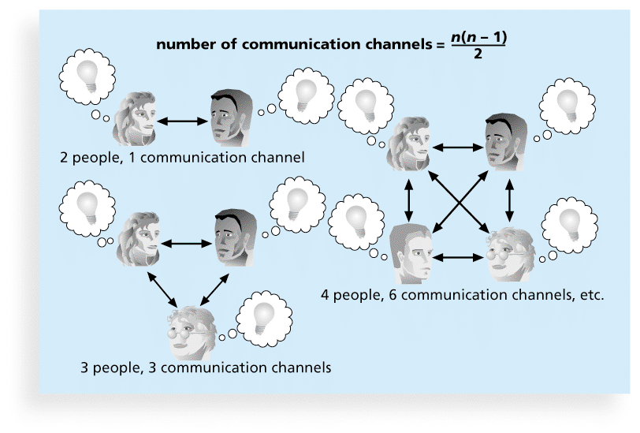
Figure 10-2. The Impact of the Number of People on Communications Channels

Slide 19
Planning Communications Management
Every project should include some type of communications management plan, a document that guides project communications
The communications management plan varies with the needs of the project, but some type of written plan should always be prepared
For small projects, the communications management plan can be part of the team contract
For large projects, it should be a separate document

Slide 20
Communications Management Plan Contents
1. Stakeholder communications requirements
2. Information to be communicated, including format, content, and level of detail
3. Who will receive the information and who will produce it
4. Suggested methods or technologies for conveying the information
5. Frequency of communication
6. Escalation procedures for resolving issues
7. Revision procedures for updating the communications management plan
8. A glossary of common terminology

Slide 21
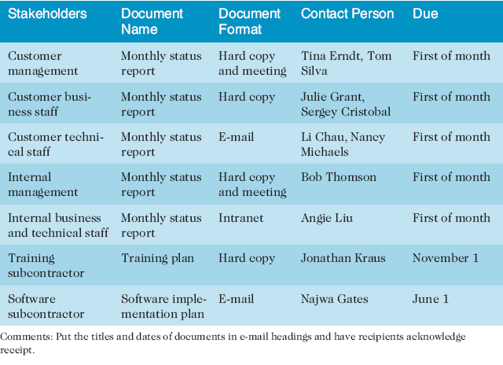
Table 10-1. Sample Stakeholder Analysis for Project Communications

Slide 22
Managing Communications
Managing communications is a large part of a project manager’s job
Getting project information to the right people at the right time and in a useful format is just as important as developing the information in the first place
Important considerations include the use of technology, the appropriate methods and media to use, and performance reporting

Slide 23
Using Technology to Enhance Creation and Distribution
Technology can facilitate the process of creating and distributing information, when used properly
It is important to select the appropriate communication method and media

Slide 24
Global Issues
Natural disasters often disrupt communications around the world. For example, the scale of the damage to Japan’s communications infrastructure after a 9.0 magnitude earthquake in March 2011 was unprecedented. Fortunately, thousands of employees from NTT East worked around the clock to restore communications.
During the April 2015 earthquake in Nepal, people turned to older technology like ham radios to communicate
Danish researchers are working on a new device called Reachi to aid communications during natural disasters

Slide 25
Classifications for Communication Methods
Interactive communication: Two or more people interact to exchange information via meetings, phone calls, or video conferencing. Most effective way to ensure common understanding
Push communication: Information is sent or pushed to recipients without their request via reports, e-mails, faxes, voice mails, and other means. Ensures that the information is distributed, but does not ensure that it was received or understood
Pull communication: Information is sent to recipients at their request via Web sites, bulletin boards, e-learning, knowledge repositories like blogs, and other means

Slide 26
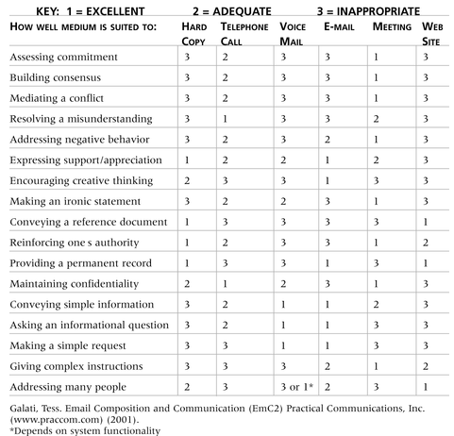
Table 10-2. Media Choice Table

Slide 27
What Went Wrong?
Collaboration is a key driver of overall performance of companies around the world
Of all the collaboration technologies that were studied, three were more commonly present in high-performing companies than in low-performing ones: Web conferencing, audio conferencing, and meeting-scheduler technologies
The study also showed that there are regional differences in how people in various countries prefer to communicate with one another
A follow-up study showed that the highest returns were in the areas of sales performance and innovations and new product development

Slide 28
Reporting Performance
Performance reporting keeps stakeholders informed about how resources are being used to achieve project objectives
Status reports describe where the project stands at a specific point in time
Progress reports describe what the project team has accomplished during a certain period of time
Forecasts predict future project status and progress based on past information and trends

Slide 29
Controlling Communications
The main goal of controlling communications is to ensure the optimal flow of information throughout the entire project life cycle
The project manager and project team should use their various reporting systems, expert judgment, and meetings to assess how well communications are working. If problems exist, the project manager and team need to take action, which often requires changes to the earlier processes of planning and managing project communications
It is often beneficial to have a facilitator from outside the project team assess how well communications are working

Slide 30
Suggestions for Improving Project Communications
Develop better communication skills
Run effective meetings
Use e-mail and other technologies effectively
Use templates for project communications

Slide 31
Developing Better Communication Skills
Most companies spend a lot of money on technical training for their employees, even when employees might benefit more from communications training
Individual employees are also more likely to enroll voluntarily in classes to learn the latest technology than in classes that develop soft skills
As organizations become more global, they realize they must invest in ways to improve communication with people from different countries and cultures
It takes leadership to improve communication

Slide 32
Media Snapshot
93 percent of recruiters check out social media profiles of prospective hires
A 2014 article in Money magazine provides a list of social media blunders that cost millennial a job or something worse, including:
Posting something embarrassing on the corporate Twitter feed
Sexual oversharing
Revealing company secrets
Making fun of your boss/team
Posting while you’re supposed to be working

Slide 33
Running Effective Meetings
Determine if a meeting can be avoided
Define the purpose and intended outcome of the meeting
Determine who should attend the meeting
Provide an agenda to participants before the meeting
Prepare handouts and visual aids, and make logistical arrangements ahead of time
Run the meeting professionally
Set the ground rules for the meeting
Build relationships

Slide 34
Using E-Mail, Instant Messaging, Texting, and Collaborative Tools Effectively
Make sure that e-mail, instant messaging, texting, or collaborative tools are an appropriate medium for what you want to communicate
Be sure to send information to the right people
Use meaningful subject lines and limit the content of emails to one main subject, and be as clear and concise as possible
Be sure to authorize the right people to share and edit your collaborative documents

Slide 35
Sample Collaborative Tools
A SharePoint portal allows users to create custom Web sites to access documents and applications stored on shared devices
Google Docs allow users to create, share, and edit documents, spreadsheets, and presentations online
A wiki is a Web site designed to enable anyone who accesses it to contribute or modify Web page content
Kanban boards visually show tasks that need to be done, are in progress, or are completed

Slide 36
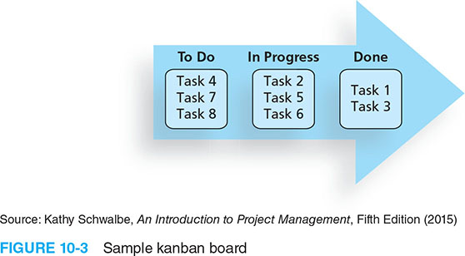
Figure 10-3. Sample Kanban Board

Slide 37
Using Templates for Project Communications
Many technical people are afraid to ask for help
Providing examples and templates for project communications saves time and money
Organizations can develop their own templates, use some provided by outside organizations, or use samples from textbooks
Recall that research shows that companies that excel in project management make effective use of templates

Slide 38
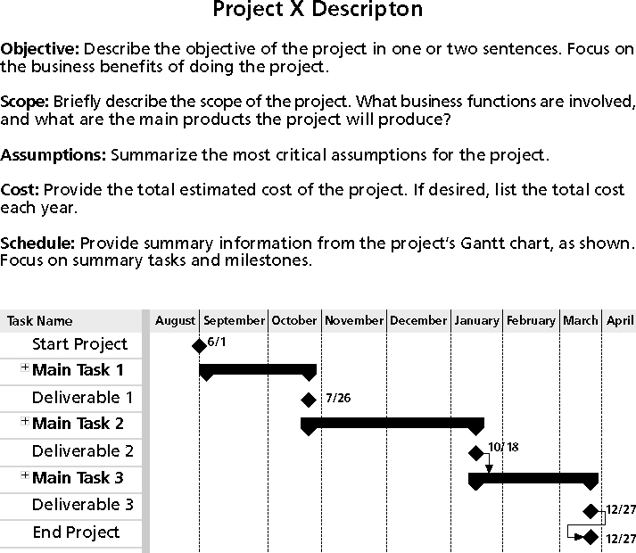
Figure 10-3. Sample Template for a Project Description

Slide 39
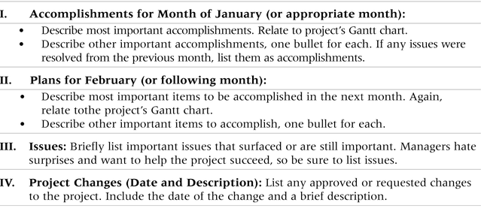
Table 10-3. Sample Template for a Monthly Progress Report

Slide 40
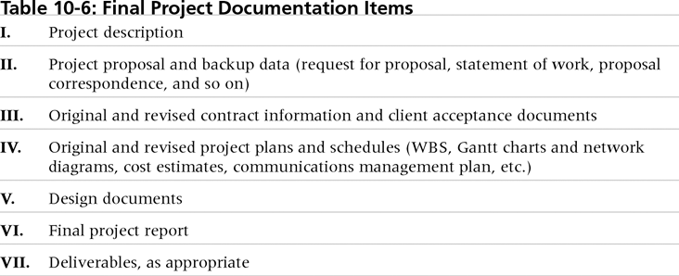
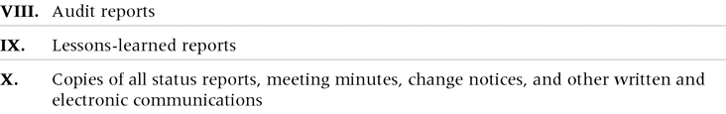
Table 10-4. Final Project Documentation Items

Slide 41
Lessons Learned Reports
The project manager and project team members should each prepare a lessons-learned report
A reflective statement that documents important things an individual learned from working on the project
The project manager often combines information from all of the lessons-learned reports into a project summary report
See template and sample in Chapter 3

Slide 42
Project Archives
It is also important to organize and prepare project archives
Project archives are a complete set of organized project records that provide an accurate history of the project
These archives can provide valuable information for future projects as well

Slide 43
Project Web Sites
Many project teams create a project Web site to store important product documents and other information
Can create the site using various types of software, such as enterprise project management software
Several project management tools can be used on multiple devices

Slide 44
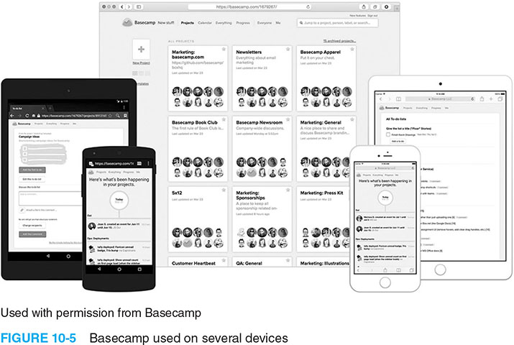
Figure 10-5. Basecamp Used on Several Devices

Slide 45
Using Software to Assist in Project Communications
There are many software tools to aid in project communications
Today many people telecommute or work remotely at least part-time
Project management software includes new capabilities to enhance virtual communications
While technology can aid in the communications process, it is not the most important. Far more important is improving an organization’s ability to communicate, which often involves cultural change

Slide 46
Chapter Summary
The goal of project communications management is to ensure timely and appropriate generation, collection, dissemination, storage, and disposition of project information
Main process include:
Plan communications management
Manage communications
Control communications

